Slide 1

LA French Tech Beyrouth
Presentation
There’s never been a better time to join, found or invest in a startup in France. We have built a branch website for La French Tech and is looking for talents from all over the world to join the adventure.

Slide 2





Demo
Processes
About French Tech
Challenges

Slide 3

About French Tech
*Some Clarifications*
What is “La French Tech” ?
Her mission ?
How France helps Startups ?
French Tech Beyrouth ?

Slide 4
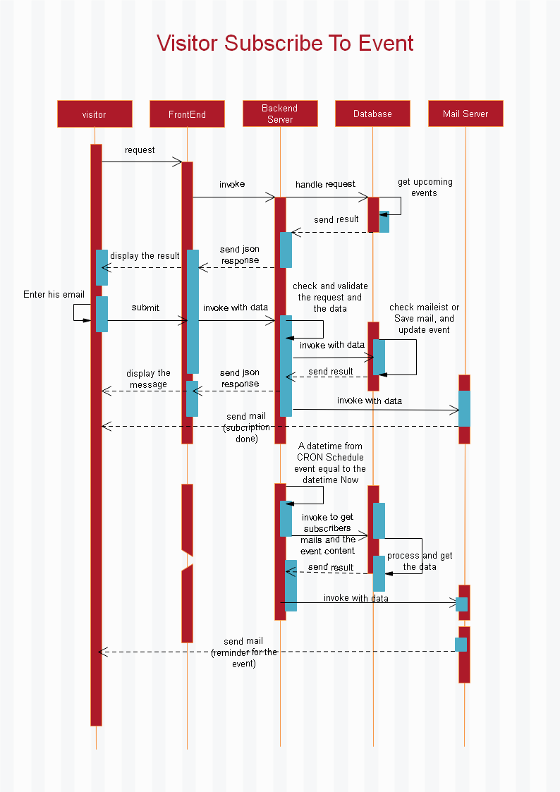
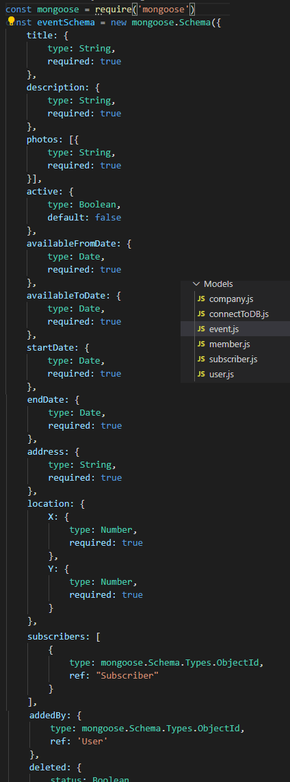
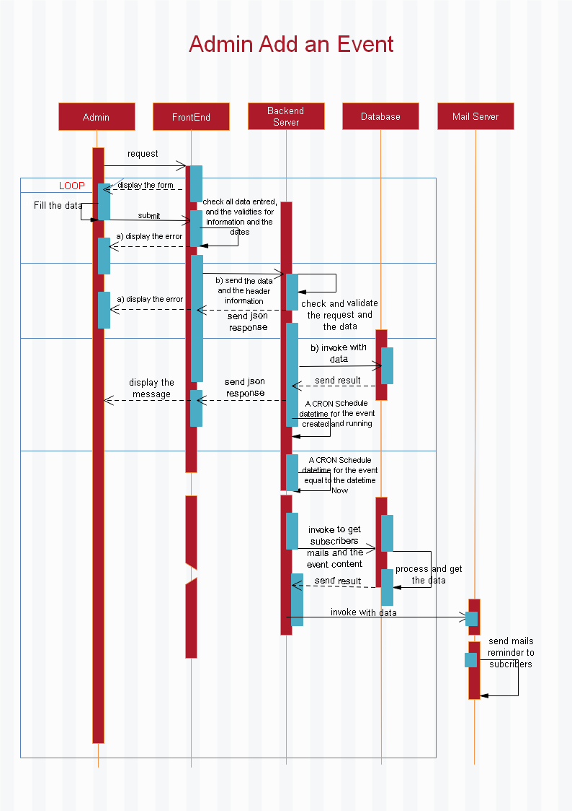
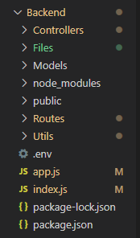
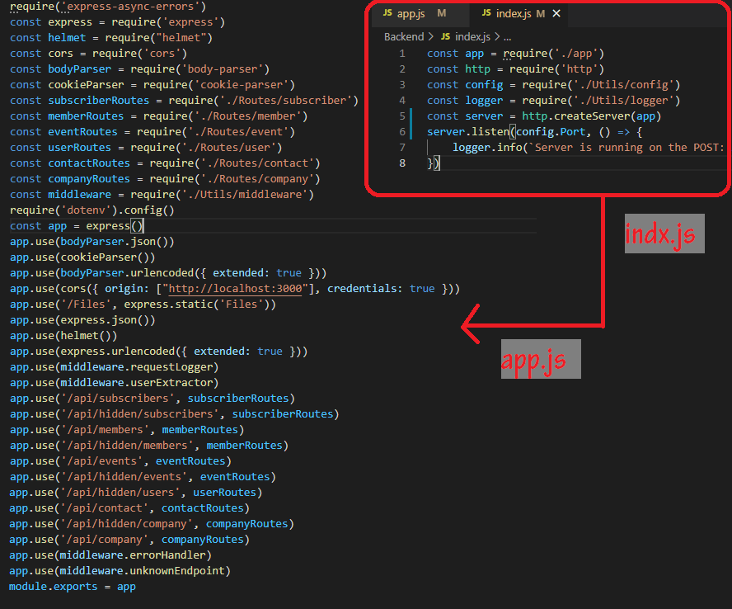
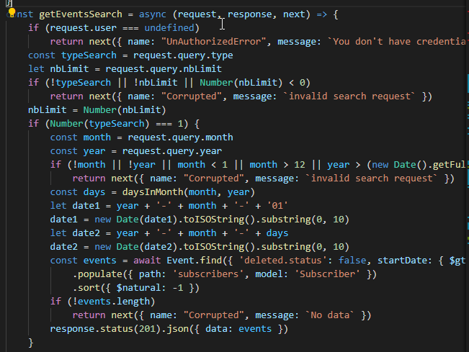
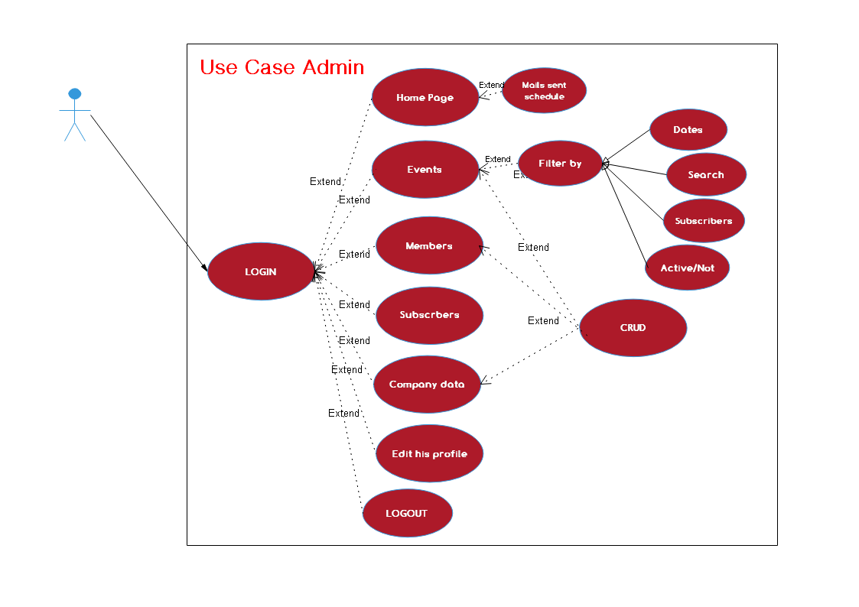
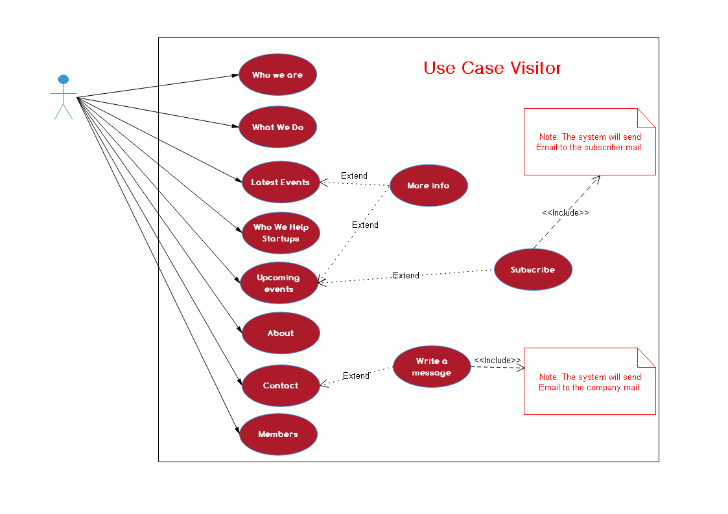
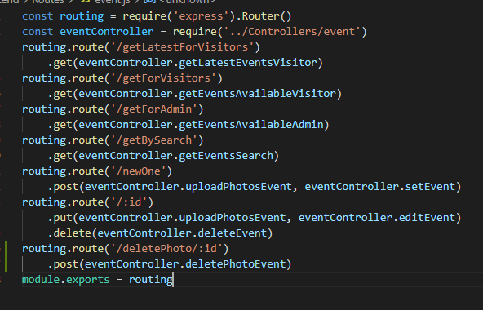
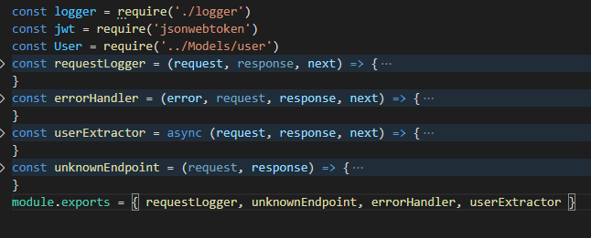
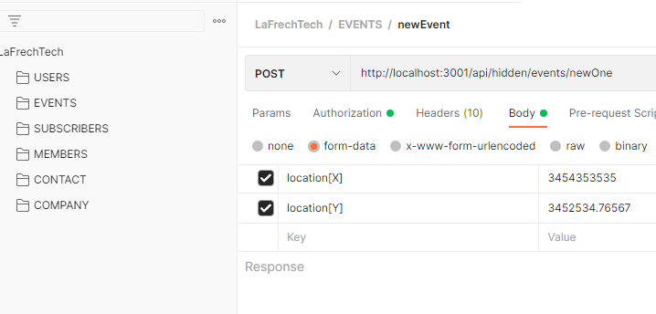
Process
1. Uml Diagram
Use case visitors:
Use case admin:
One sequence for visitor:
One sequence for admin:
2. Create Server
Http server:
Middleware:
3. Data base
Schemas:
Controllers:
Routing:
4. Hierarchy
4. Testing
Postman:

Slide 5
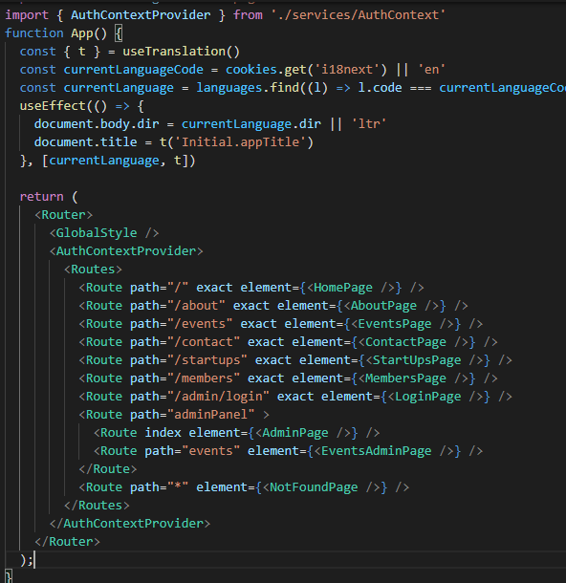
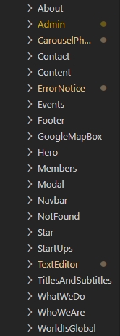
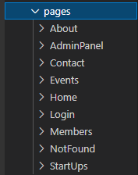
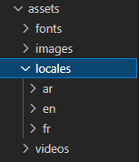
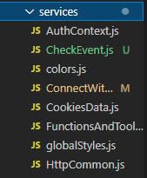
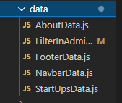
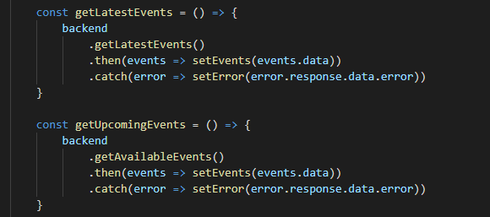
Process
1. Set up the first step in front end
Create the react app:
Install initial modules:
Build the routes:
2. Sketching the website
3. Create the pages
4. Create the components
5. Set up the static data for components.
6. Set up the translation text.
7. Set up the services data.
8. Testing.

Slide 6
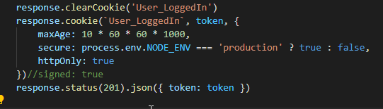
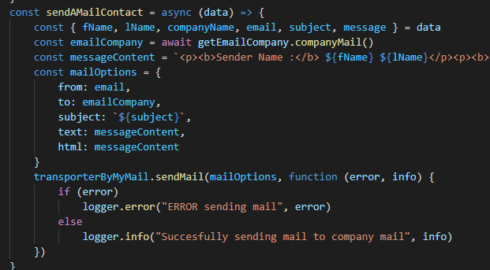
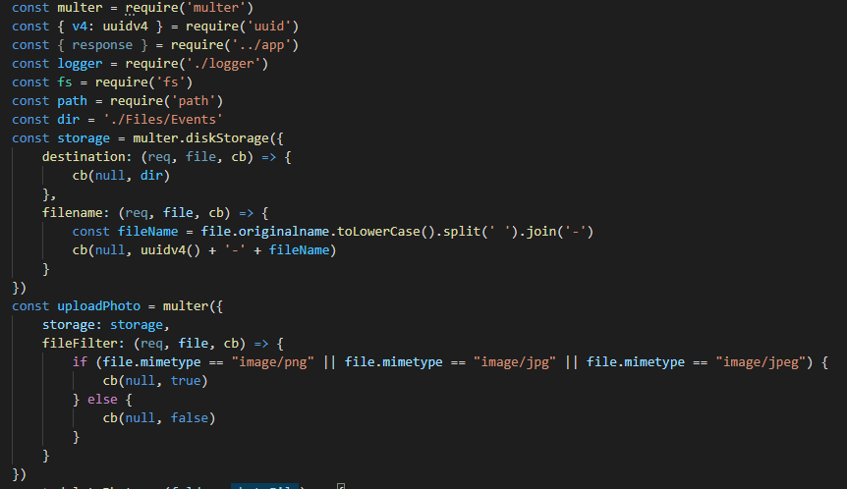
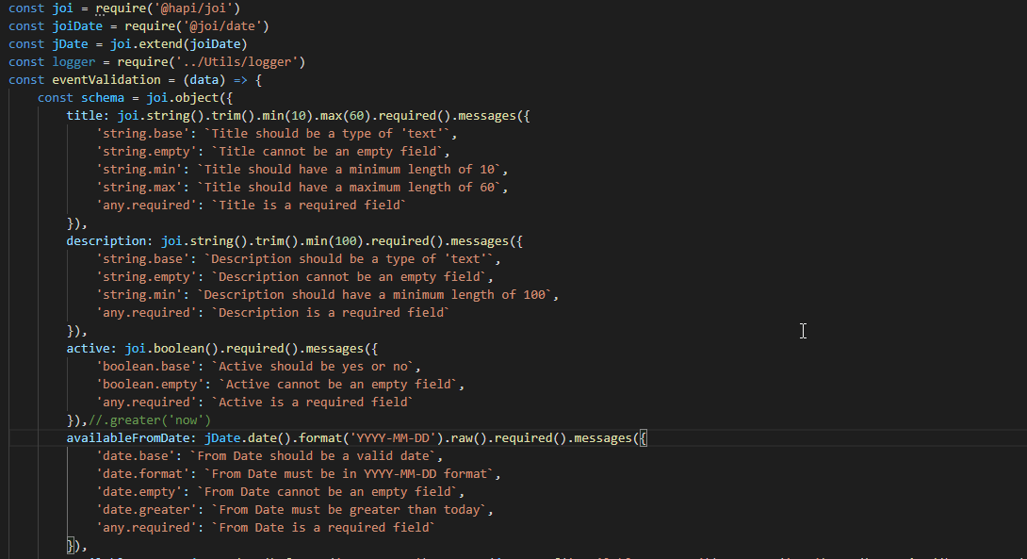
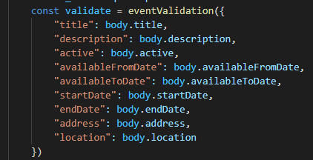
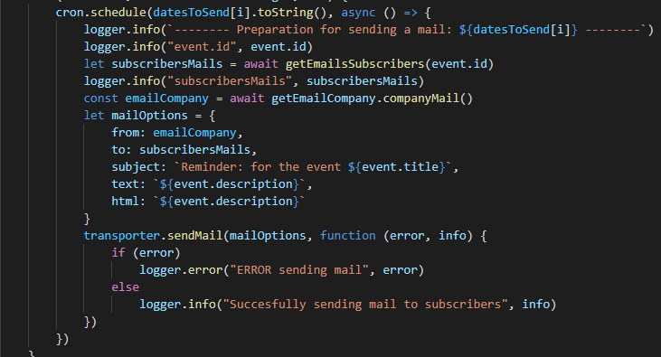
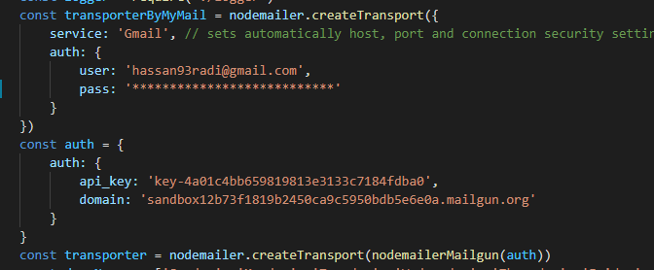
Process
Back end packages:
@hapi/joi - @joi/date:
bcrypt:
body-parser:
cookie-parser:
cors:
dotenv:
express:
express-async-errors:
file-system:
helmet:
jsonwebtoken:
moment-timezone:
mongoose:
multer:
node-cron:
nodemailer:
nodemailer-mailgun-transport:
nodemon:
Uuid:

Slide 7
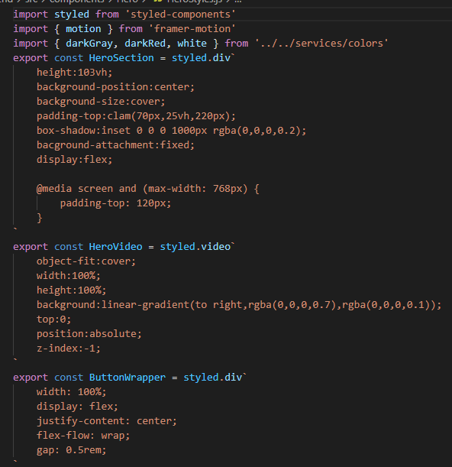
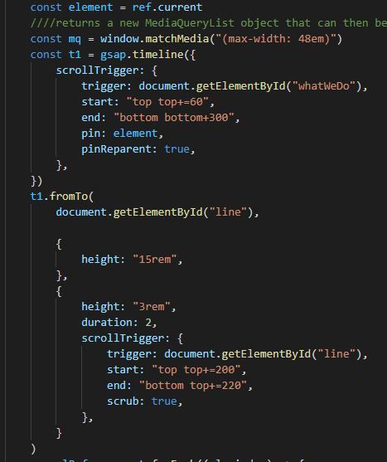
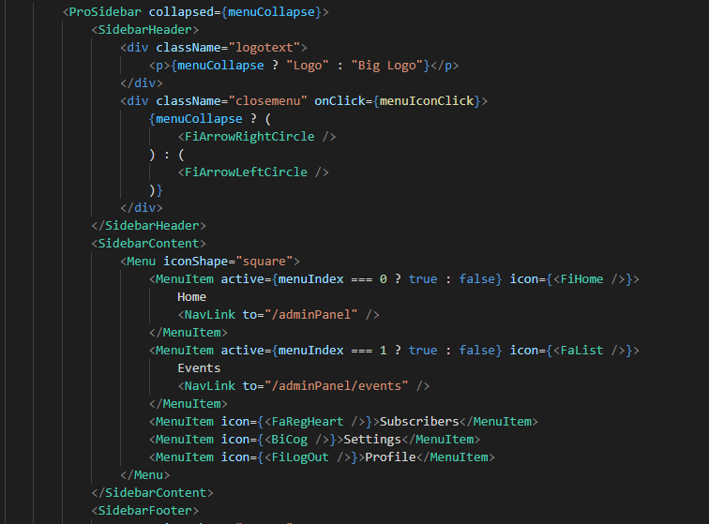
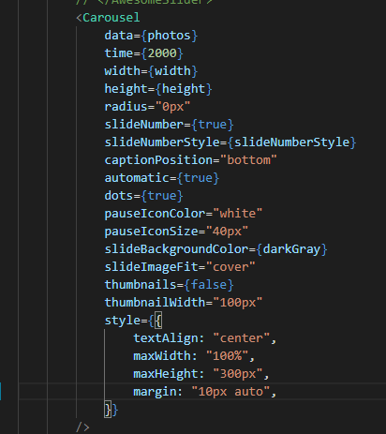
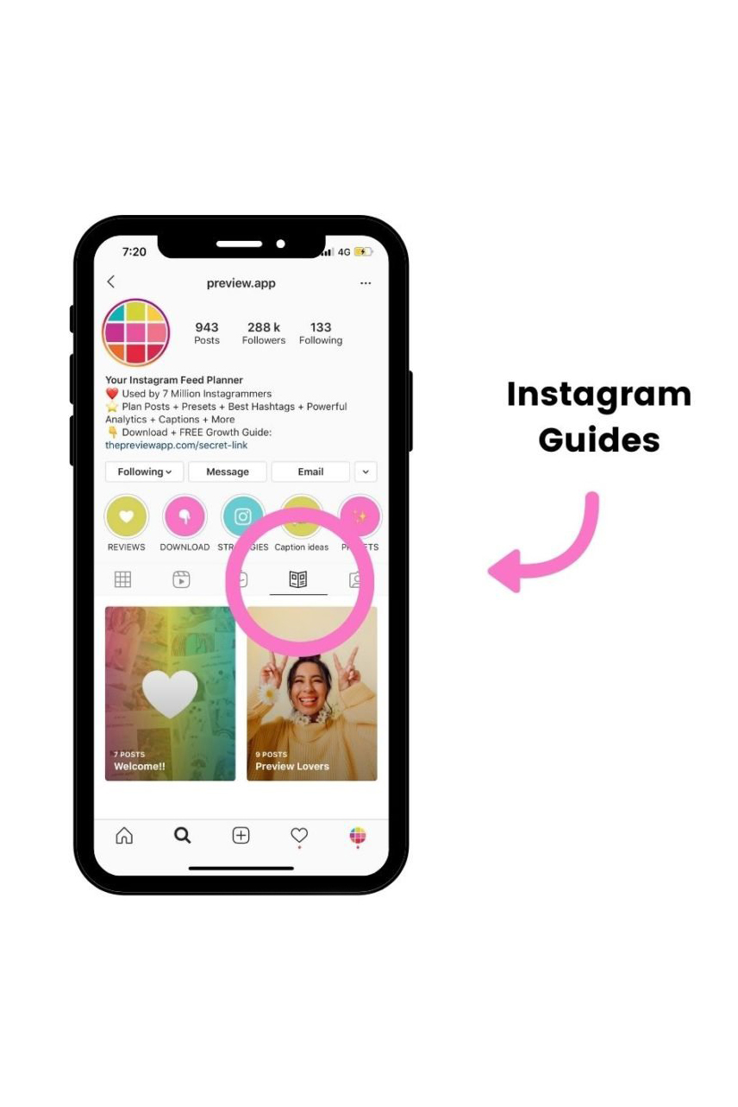
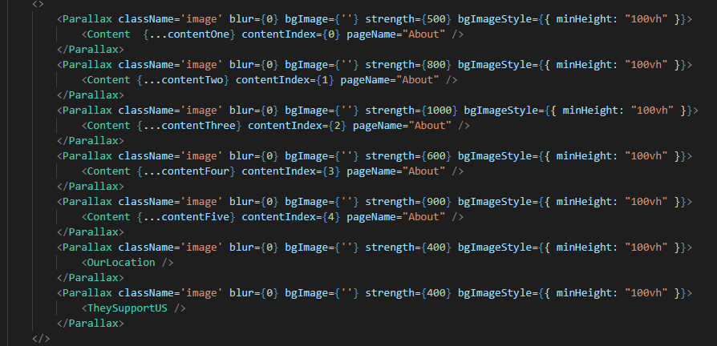
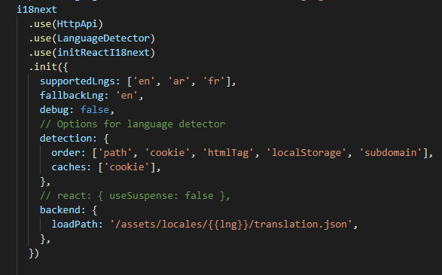
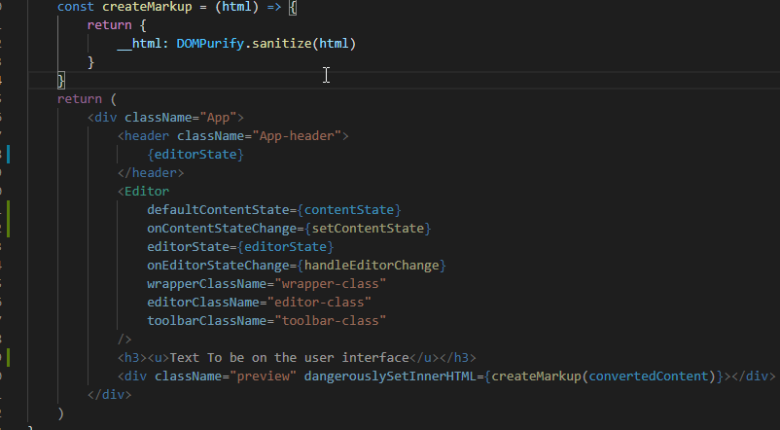
Process
Front end package:
dompurify:
draft-js:
flag-icons:
framer-motion:
gsap:
i18next:
js-cookie:
react-awesome-slider:
react-icons:
react-intersection-observer:
react-parallax:
react-player:
react-pro-sidebar:
react-router-dom:
react-scroll:
styled-components: @hapi/joi

Slide 8
?
Content Road Map
1) Research other people’s Content
75% trends & 25% evergreen videos
2) Research our HASHTAGS
Between 100 k – 2 millions views
3) Publication Schedule
Posting 2-3 videos per week on tiktok and insta reel
Daily Stories on insta/fb
Monthly videos on insta/fb ( campaign uses )
WHAT OPTIONS do we need ?
4) Account Authority
The platform’s algorithm highly affects the profile by:
The first five videos
Theme uniformity and consistency
View tiers (Engagement, video loop…)

Slide 9


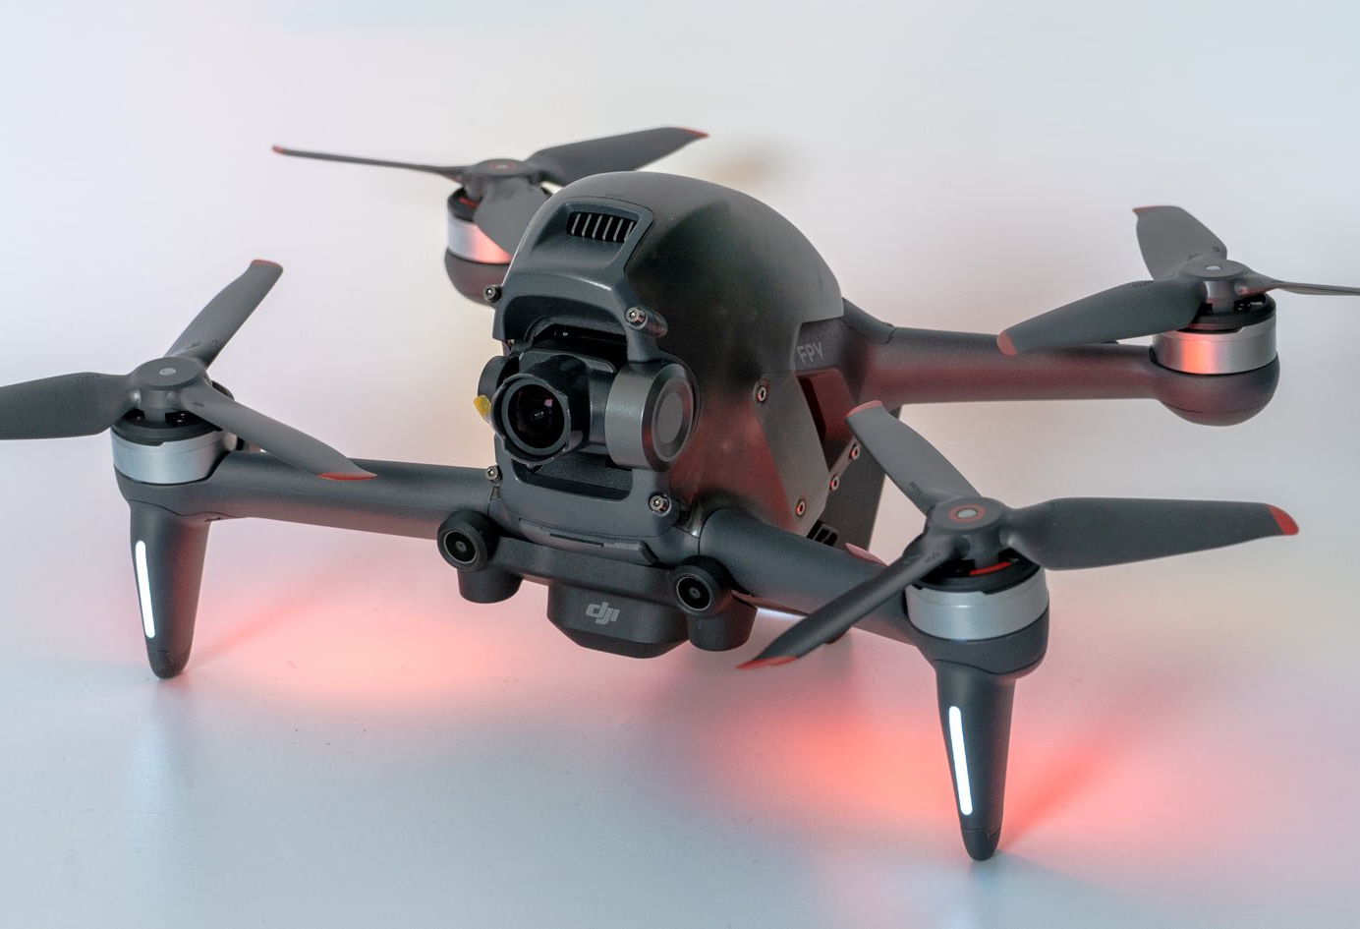
Account Quality
Preserving consistency for each platform
Picking the right time for posting
Posting daily stories to keep the accounts active
Image quality is important to attract the audience with magnificent shots and to beautifully express the details of any given villa during day and night. (In low light and high light conditions)

Slide 10

Data Analytics
Checking that the engagement levels meet our expectations:
Engagement based on age rang and nationalities
Adapting the type of trends to the culture of the most viewers
Improving the gaps between the types of viewers (Gender)
Monthly meeting with HOVI to obtain the analytics concerning the advertisement campaign.
Exact numbers of leading potential customers on website
Engagement levels based on social media profiles clicks
Each platform has a Data Analytics

Slide 11

T h a n k Y o u
FOR YOUR ATTENTION

